Slide 1
Imdb Movie Recommendation System Natural Language Processing | Recommendation Systems
By Arjun

Slide 2
Problem Statement
This project focuses on extracting movie data from IMDb for 2024, specifically focusing on the movie name and storyline. Using Selenium, the program will scrape IMDb to collect movie names and their associated storylines. The storylines will then be pre-processed and analyzed using Natural Language Processing (NLP) techniques, such as all-MiniLM-L6-v2 (SentenceTransformers) or Count Vectorizer. Using these methods, the project will calculate Cosine Similarity (FAISS IndexFlatIP) or other Machine Learning algorithms to recommend similar movies based on a given storyline. The project will provide an interactive user interface built with Streamlit where users can input a movie storyline and receive the top 5 recommended movies.

Slide 3
Dataset Overview
Source: IMDb (scraped using Selenium)
Genres Covered: 20+ (Action, Comedy, Romance, Sci-Fi, etc.)
Files Generated:
Genre-wise CSVs (per scrape)
Final merged file → IMDB_Movies_Data.csv
Final Dataset:
Rows: ~20k+ movies
Columns:
Title (Movie Name)
Storyline (Plot description)

Slide 4
Data Cleaning
Feature Engineering
Removed duplicate movies across genres
Standardized empty/missing storylines → "N/A"
Pre-processed text:
Lowercasing
Removing digits & punctuation
Stopword removal (NLTK)
Saved clean dataset → cleaned_imdb.csv
Sentence Embeddings:
Model: all-MiniLM-L6-v2 (SentenceTransformers)
Vector size: 384 dimensions
Preprocessing:
Normalized embeddings (L2 norm) → enables
cosine similarity
Indexing:
Used FAISS IndexFlatIP (Inner Product = Cosine Similarity)
Stored in ‘faiss_index.index’ for fast retrieval

Slide 5
System Pipeline
Step 1: Web Scraping (Selenium) → Genre-wise movie titles & storylines
Step 2: Data Cleaning → Remove duplicates, clean text
Step 3: Sentence Embeddings → Encode storylines into vectors
Step 4: FAISS Indexing → Store embeddings for fast similarity search
Step 5: Recommendation Engine → Query storyline → retrieve Top-N similar movies
Step 6: Streamlit App → Interactive search + visualization
Web Scraping
Data Cleaning
Sentence Embeddings
FAISS Indexing
Recommendation Engine
Streamlit App

Slide 6
Tools Used
Step | Tools/Libraries
Scraping | Selenium, Pandas
Cleaning | Regex, NLTK
Embeddings | SentenceTransformers (all-MiniLM-L6-v2)
Indexing/Search | FAISS(Approx. Nearest Neighbors)
Visualization | Streamlit, Plotly
Evaluation
Metric Used: Cosine Similarity (0 → 1)
Higher score = more semantically similar storyline
Tested with:
Random queries → meaningful matches retrieved
Genre-specific queries → consistent recommendations

Slide 7
Streamlit App Features
Movie Recommendation UI
Input: User types storyline/description
Output: Top-N recommended movies with similarity score
Features:
Similarity Scores shown as % (e.g., 87.5%)
Interactive Plotly Bar Chart
Expandable Storyline Preview
Configurable Top-N (1–20)

Slide 8
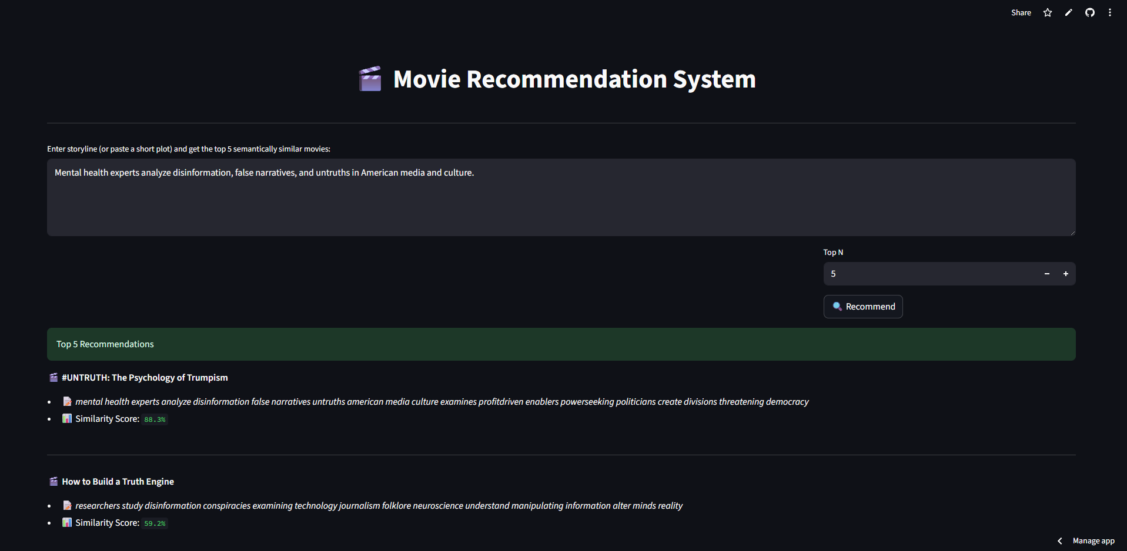
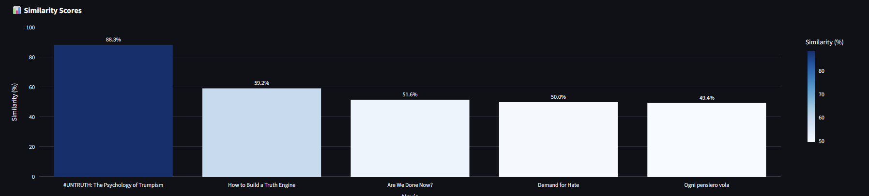
Visual Insights
Bar Chart of Similarity Scores (Top recommendations)
Movie Storyline Display (contextual relevance)
Example Query:
Input: "Mental health experts analyze disinformation, false narratives, and untruths in American media and culture."
Recommendations: Top Comedy movies with similar plots.

Slide 9
Conclusion
Successfully built semantic movie recommender.
FAISS + SentenceTransformers enabled fast & accurate retrieval.
Streamlit app provides interactive, user-friendly experience.
Future Improvements
Integrate IMDb ratings & metadata into ranking.
Use Hybrid Recommendation (content + collaborative filtering).
Add multilingual support (encode storylines in different languages).
Build a mobile app or chatbot interface.

Slide 10
Project Deliverables
IMDB_Movie_Data.csv (raw scraped data)
cleaned_imdb.csv (cleaned dataset)
embeddings.npy (vector representations)
faiss_index.index (FAISS index)
Streamlit App: Movie Recommender

Slide 11
THANK YOU

